Slide 1
Exception Handling in Java
An Exception is an unwanted or unexpected event that occurs during the execution of a program (i.e., at runtime) and disrupts the normal flow of the program’s instructions.
It occurs when something unexpected happens, like accessing an invalid index, dividing by zero, or trying to open a file that does not exist.
Exception in Java is an error condition that occurs when something wrong happens during the program execution.
Manage runtime errors by using mechanisms like
try-catch block,
finally block,
throwing Exceptions (throw and throws keyword),
Custom Exception handling, etc.

Slide 2
Advantage of Exception Handling
to maintain the normal flow of the application.
statement 1;
statement 2;
statement 3;
statement 4;
statement 5;//exception occurs
statement 6;
statement 7;
statement 8;
statement 9;
statement 10;

Slide 3
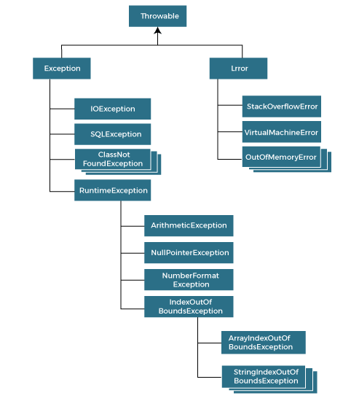
Hierarchy of Java Exception classes

Slide 4
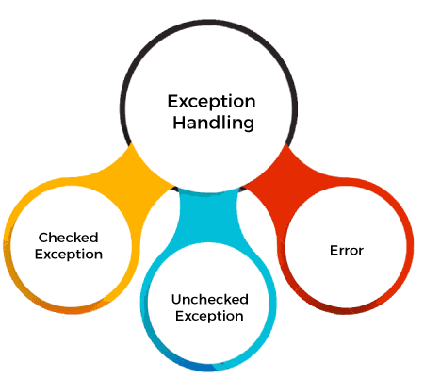
Types of Java Exceptions

Slide 5
Checked Exceptions
Exceptions that are checked at compile-time.
The compiler verifies that the code handles these exceptions either by catching them or declaring them in the method signature using the throws keyword.
Examples of checked exceptions include:
IOException: An exception is thrown when an input/output operation fails, such as when reading from or writing to a file.
SQLException: It is thrown when an error occurs while accessing a database.
ParseException: Indicates a problem while parsing a string into another data type, such as parsing a date.
ClassNotFoundException: It is thrown when an application tries to load a class through its string name using methods like Class.forName(), but the class with the specified name cannot be found in the classpath.

Slide 6
Unchecked Exceptions (Runtime Exceptions)
Usually occur due to programming errors, such as logic errors or incorrect assumptions in the code.
They do not need to be declared in the method signature using the throws keyword, making it optional to handle them.
Examples of unchecked exceptions include:
NullPointerException: It is thrown when trying to access or call a method on an object reference that is null.
ArrayIndexOutOfBoundsException: It occurs when we try to access an array element with an invalid index.
ArithmeticException: It is thrown when an arithmetic operation fails, such as division by zero.
IllegalArgumentException: It indicates that a method has been passed an illegal or inappropriate argument.

Slide 7
Errors
Exceptional conditions that are not expected to be caught under normal circumstances.
They are typically caused by issues outside the control of the application, such as system failures or resource exhaustion.
Errors are not meant to be caught or handled by application code.
Examples of errors include:
OutOfMemoryError: It occurs when the Java Virtual Machine (JVM) cannot allocate enough memory for the application.
StackOverflowError: It is thrown when the stack memory is exhausted due to excessive recursion.
NoClassDefFoundError: It indicates that the JVM cannot find the definition of a class that was available at compile-time.

Slide 8
Java Exception Keywords
Keyword | Description
try | The "try" keyword is used to specify a block where we should place an exception code. It means we can't use try block alone. The try block must be followed by either catch or finally.
catch | The "catch" block is used to handle the exception. It must be preceded by try block which means we can't use catch block alone. It can be followed by finally block later.
finally | The "finally" block is used to execute the necessary code of the program. It is executed whether an exception is handled or not.
throw | The "throw" keyword is used to throw an exception.
throws | The "throws" keyword is used to declare exceptions. It specifies that there may occur an exception in the method. It doesn't throw an exception. It is always used with method signature.

Slide 9
Exception Handling Methods
try-catch block,
finally block,
throwing Exceptions (throw and throws keyword),
Custom Exception handling, etc.

Slide 10
try-catch block
Used to enclose the code that might throw an exception.
If an exception occurs at the particular statement in the try block, the rest of the block code will not execute.
Do Not keep the code in try block that will not throw an exception.
//handling single exception
try {
// Code that may throw an exception
} catch (Exception e) {
// Exception handling code
}
//handling multiple exception
try {
// Code that may throw an exception
} catch (IOException e) {
// Handle IOException
} catch (NumberFormatException e) {
// Handle NumberFormatException
} catch (Exception e) {
// Handle any other exceptions
}

Slide 11
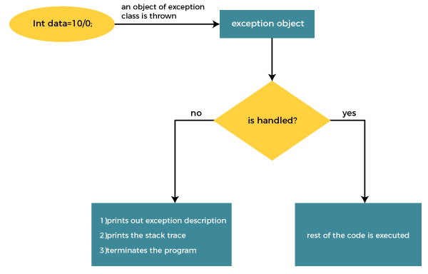
try-catch block

Slide 12
try-catch block
Problem without Exception Handling
public class TryCatchExample1 {
public static void main(String[] args) {
int data=50/0; //may throw exception
System.out.println("rest of the code");
}
}
Output:
Exception in thread "main" java.lang.ArithmeticException: / by zero

Slide 13
try-catch block
Solution by Exception Handling
public class TryCatchExample2 {
public static void main(String[] args) {
try {
int data=50/0; //may throw exception
}
catch(ArithmeticException e) {
System.out.println(e);
}
System.out.println("rest of the code");
}
}
Output:
java.lang.ArithmeticException: / by zero
rest of the code

Slide 14
The try-catch Block
//Java Program to illustrate the use of Arithmetic Exception in Java
public class Main {
public static void main(String[] args) {
int dividend = 10;
int divisor = 0;
try {
int result = dividend / divisor; // Division by zero
System.out.println("Result: " + result);
} catch (ArithmeticException e) {
System.out.println("Error: Division by zero is not allowed.");
// Additional error handling code can be added here
}
}
}

Slide 15
The try-catch Block
//Java Program to illustrate the use of Null Pointer Exception in Java
public class Main {
public static void main(String[] args) {
String str = null; // Initializing a String variable to null
try {
int length = str.length(); // Attempting to call a method on a null reference
System.out.println("Length of the string: " + length);
} catch (NullPointerException e) {
System.out.println("Error: Null reference encountered.");
// Additional error handling code can be added here
}
}
}

Slide 16
The try-catch Block
//Java Program to illustrate the use of Number Format Exception in Java
public class Main {
public static void main(String[] args) {
String str = "abc"; // Initializing a String with non-numeric characters
try {
int num = Integer.parseInt(str); // Attempting to parse a non-numeric string to an integer
System.out.println("Parsed number: " + num);
} catch (NumberFormatException e) {
System.out.println("Error: Unable to parse the string as an integer.");
// Additional error handling code can be added here
}
}
}

Slide 17
The try-catch Block
//Java Program to illustrate the use of ArrayIndexOutOfBoundsException in Java
public class Main {
public static void main(String[] args) {
int[] numbers = {1, 2, 3, 4, 5}; // Initializing an array with 5 elements
try {
int index = 10; // Accessing an index that is out of bounds
int value = numbers[index]; // Attempting to access an element at an invalid index
System.out.println("Value at index " + index + ": " + value);
} catch (ArrayIndexOutOfBoundsException e) {
System.out.println("Error: Index is out of bounds.");
// Additional error handling code can be added here
}
}
}

Slide 18
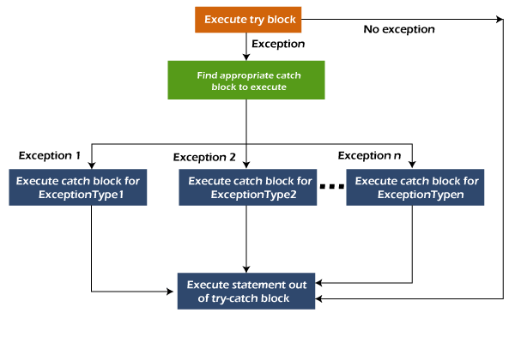
Java Multi-catch block
At a time only one exception occurs and at a time only one catch block is executed.
All catch blocks must be ordered from most specific to most general, i.e. catch for ArithmeticException must come before catch for Exception.

Slide 19
Java Multi-catch block
public class MultipleCatchBlock1 {
public static void main(String[] args) {
try{
int a[]=new int[5];
a[5]=30/0;
}
catch(ArithmeticException e) {
System.out.println("Arithmetic Exception occurs");
}
catch(ArrayIndexOutOfBoundsException e) {
System.out.println("ArrayIndexOutOfBounds Exception occurs");
}
catch(Exception e) {
System.out.println("Parent Exception occurs");
}
System.out.println("rest of the code");
}
}
Output:
Arithmetic Exception occurs
rest of the code

Slide 20
Java Multi-catch block
public class MultipleCatchBlock2 {
public static void main(String[] args) {
try{
int a[]=new int[5];
System.out.println(a[10]);
}
catch(ArithmeticException e) {
System.out.println("Arithmetic Exception occurs");
}
catch(ArrayIndexOutOfBoundsException e) {
System.out.println("ArrayIndexOutOfBounds Exception occurs");
}
catch(Exception e) {
System.out.println("Parent Exception occurs");
}
System.out.println("rest of the code");
}
}
Output:
ArrayIndexOutOfBounds Exception occurs
rest of the code

Slide 21
Java Multi-catch block
public class MultipleCatchBlock3 {
public static void main(String[] args) {
try{
int a[]=new int[5];
a[5]=30/0;
System.out.println(a[10]);
}
catch(ArithmeticException e) {
System.out.println("Arithmetic Exception occurs");
}
catch(ArrayIndexOutOfBoundsException e) {
System.out.println("ArrayIndexOutOfBounds Exception occurs");
}
catch(Exception e) {
System.out.println("Parent Exception occurs");
}
System.out.println("rest of the code");
}
}
Output:
Arithmetic Exception occurs
rest of the code

Slide 22
Java Multi-catch block
public class MultipleCatchBlock4 {
public static void main(String[] args) {
try{
String s=null;
System.out.println(s.length());
}
catch(ArithmeticException e) {
System.out.println("Arithmetic Exception occurs");
}
catch(ArrayIndexOutOfBoundsException e) {
System.out.println("ArrayIndexOutOfBounds Exception occurs");
}
catch(Exception e) {
System.out.println("Parent Exception occurs");
}
System.out.println("rest of the code");
}
}
Output:
Parent Exception occurs"
rest of the code

Slide 23
Java Multi-catch block: without the order of exceptions
class MultipleCatchBlock5{
public static void main(String args[]){
try{
int a[]=new int[5];
a[5]=30/0;
}
catch(Exception e){
System.out.println("common task completed");
}
catch(ArithmeticException e){
System.out.println("task1 is completed");
}
catch(ArrayIndexOutOfBoundsException e){
System.out.println("task 2 completed");
}
System.out.println("rest of the code...");
}
}
Output:
Compile-time error

Slide 24
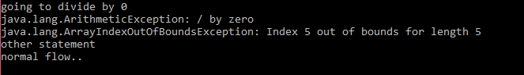
Java Nested try Example
public class NestedTryBlock{
public static void main(String args[]){
try{ //Outer try block
try{ //inner try block1
System.out.println("going to divide by 0");
int b =39/0;
}
catch(ArithmeticException e) { //inner catch block1
System.out.println(e);
}
try{ //inner tryblock2
int a[]=new int[5];
a[5]=4;
}
catch(ArrayIndexOutOfBoundsException e) { //inner catch block1
System.out.println(e);
}
System.out.println("other statement");
}
catch(Exception e) { //outer catch block
System.out.println("handled the exception (outer catch)");
}
System.out.println("normal flow..");
}
}

Slide 25
The finally Block
allows you to execute cleanup code, such as closing resources, regardless of whether an exception occurs or not.
The finally block is typically used to release resources that were acquired in the try block.
public class TestFinallyBlock2{
public static void main(String args[]){
try {
int data=25/0;
}
catch(ArithmeticException e){
System.out.println(e);
}
finally {
System.out.println("finally block is always executed");
}
System.out.println("rest of the code...");
}
}
Output:
java.lang.ArithmeticException: / by zero
finally block is always executed

Slide 26
Java throw Exception
The Java throw keyword is used to throw an exception explicitly.
The Exception has some message with it that provides the error description.
Throw either checked or unchecked exceptions.
It is mainly used to throw a custom exception.
Define our own set of conditions and throw an exception explicitly
Syntax:
throw new exception_class("error message");

Slide 27
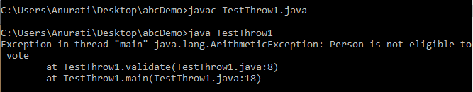
Java throw Exception:
public class TestThrow1 {
//function to check if person is eligible to vote or not
public static void validate(int age) {
if(age<18) {
//throw Arithmetic exception if not eligible to vote
throw new ArithmeticException("Person is not eligible to vote");
}
else {
System.out.println("Person is eligible to vote!!");
}
}
//main method
public static void main(String args[]){
try{
validate(13); }
catch(ArithmeticException e)
{ System.out.println(e); }
System.out.println("rest of the code...");
}
}

Slide 28

Java throw Exception
public class ThrowDemo {
public static void Division()
{
int result=10/0;
throw new ArithmeticException();
}
public static void main(String args[])
{
try {
Division();
} catch (ArithmeticException e) {
System.out.println("Exception handled");
System.out.println(e.fillInStackTrace());
}
}
}

Slide 29
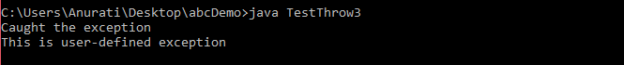
Java throw Exception: Throwing User-defined Exception
class UserDefinedException extends Exception {
public UserDefinedException(String str) {
// Calling constructor of parent Exception
super(str);
}
}
public class TestThrow3 {
public static void main(String args[]) {
try {
// throw an object of user defined exception
throw new UserDefinedException("This is user-defined exception");
}
catch (UserDefinedException ude) {
System.out.println("Caught the exception");
System.out.println(ude.getMessage());
}
}
}

Slide 30
Java throws keyword
Used to declare an exception.
It gives an information to the programmer that there may occur an exception.
So, it is better for the programmer to provide the exception handling code so that the normal flow of the program can be maintained.
Exception Handling is mainly used to handle the checked exceptions.
Syntax:
return_type method_name() throws exception_class_name{
//method code
}

Slide 31
Java throw Exception: Throwing User-defined Exception
import java.io.*;
class M{
void method() throws IOException{
throw new IOException("device error");
}
}
public class Testthrows2{
public static void main(String args[]){
try{
M m=new M();
m.method();
}catch(Exception e){System.out.println("exception handled:"+e);}
System.out.println("normal flow...");
}
}

Slide 32
Java throw Exception: Throwing User-defined Exception
public class TestThrows {
public static int divideNum(int m, int n) throws ArithmeticException {
if(n==0)
{
throw new ArithmeticException(“Number cannot be divided by 0”);
} else
{
int div = m / n;
return div;
}
}
public static void main(String[] args) {
TestThrows obj = new TestThrows();
try {
System.out.println(obj.divideNum(45, 0));
}
catch (ArithmeticException e){
System.out.println("Error message"+e);
}
System.out.println("Rest of the code..");
}
}

Slide 33
Java throws keyword
S.N. | Basis of Differences | throw | throws
1. | Definition | Java throw keyword is used throw an exception explicitly in the code, inside the function or the block of code. | Java throws keyword is used in the method signature to declare an exception which might be thrown by the function while the execution of the code.
2. | Uses | Type of exception Using throw keyword, we can only propagate unchecked exception i.e., the checked exception cannot be propagated using throw only. | Using throws keyword, we can declare both checked and unchecked exceptions. However, the throws keyword can be used to propagate checked exceptions only.
3. | Syntax | The throw keyword is followed by an instance of Exception to be thrown. | The throws keyword is followed by class names of Exceptions to be thrown.
4. | Declaration | The keyword throw is used within the method. | The keyword throws is used with the method signature.
5. | Internal Implementation | We are allowed to throw only one exception at a time i.e. we cannot throw multiple exceptions. | We can declare multiple exceptions using throws keyword that can be thrown by the method. For example, main() throws IOException, SQLException.

Slide 34
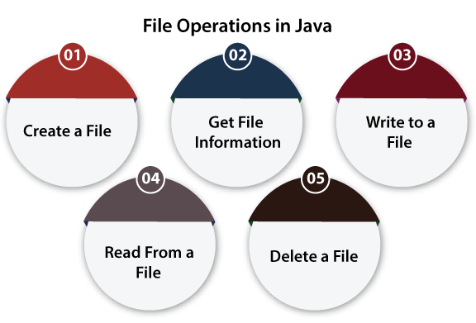
File Handling in Java
A named location used to store related information is known as a File.

Slide 35
Stream
A series of data is referred to as a stream.
Byte Stream
Byte Stream is mainly involved with byte data.
A file handling process with a byte stream is a process in which an input is provided and executed with the byte data.
Character Stream
Character Stream is mainly involved with character data.
A file handling process with a character stream is a process in which an input is provided and executed with the character data.

Slide 36
Java File Class Methods
SN | Method | Return Type | Description
1. | canRead() | Boolean | The canRead() method is used to check whether we can read the data of the file or not.
2. | createNewFile() | Boolean | The createNewFile() method is used to create a new empty file.
3. | canWrite() | Boolean | The canWrite() method is used to check whether we can write the data into the file or not.
4. | exists() | Boolean | The exists() method is used to check whether the specified file is present or not.
5. | delete() | Boolean | The delete() method is used to delete a file.
6. | getName() | String | The getName() method is used to find the file name.
7. | getAbsolutePath() | String | The getAbsolutePath() method is used to get the absolute pathname of the file.
8. | length() | Long | The length() method is used to get the size of the file in bytes.
9. | list() | String[] | The list() method is used to get an array of the files available in the directory.
10. | mkdir() | Boolean | The mkdir() method is used for creating a new directory.

Slide 37
Create a File: createNewFile() method
import java.io.File;
import java.io.IOException;
class CreateFile {
public static void main(String args[]) {
try {
// Creating an object of a file
File f0 = new File("D:FileOperationExample.txt");
if (f0.createNewFile()) {
System.out.println("File is created successfully.");
} else {
System.out.println("File is already exist in the directory.");
}
} catch (IOException exception) {
System.out.println("An unexpected error is occurred.");
exception.printStackTrace();
}
}
}

Slide 38
Get File Information
import java.io.File;
class FileInfo {
public static void main(String[] args) {
File f0 = new File("D:FileOperationExample.txt");
if (f0.exists()) {
System.out.println("The name of the file is: " + f0.getName());
System.out.println("The absolute path of the file is: " + f0.getAbsolutePath()); System.out.println("Is file writeable?: " + f0.canWrite());
System.out.println("Is file readable " + f0.canRead());
System.out.println("The size of the file in bytes is: " + f0.length());
} else {
System.out.println("The file does not exist.");
}
}
}

Slide 39
Write to a File: FileWriter class
import java.io.FileWriter;
import java.io.IOException;
class WriteToFile {
public static void main(String[] args) {
try {
FileWriter fwrite = new FileWriter("D:FileOperationExample.txt");
fwrite.write("A named location used to store related information is referred to as a File.");
fwrite.close();
System.out.println("Content is successfully wrote to the file.");
} catch (IOException e) {
System.out.println("Unexpected error occurred");
e.printStackTrace();
}
}
}

Slide 40
Read from a File: Scanner class
import java.io.File;
import java.io.FileNotFoundException;
import java.util.Scanner;
class ReadFromFile {
public static void main(String[] args) {
try {
File f1 = new File("D:FileOperationExample.txt");
Scanner dataReader = new Scanner(f1);
while (dataReader.hasNextLine()) {
String fileData = dataReader.nextLine();
System.out.println(fileData);
}
dataReader.close();
} catch (FileNotFoundException exception) {
System.out.println("Unexcpected error occurred!");
exception.printStackTrace();
}
}
}

Slide 41
Delete a File: delete() method
import java.io.File;
class DeleteFile {
public static void main(String[] args) {
File f0 = new File("D:FileOperationExample.txt");
if (f0.delete()) {
System.out.println(f0.getName()+ " file is deleted successfully.");
} else {
System.out.println("Unexpected error found in deletion of the file.");
}
}
}

